Slide 1






Why Aren’t Regular Expressions
a Lingua Franca?
James Davis
Mischa Michael
Christy Coghlan
Francisco Servant
Dongyoon Lee
Notes:
By “lingua franca”, I mean a common language shared by several parties – in this case, PLs

Slide 2

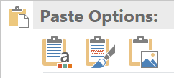



Summary of Contributions
Developer perspectives Survey of 158 devs
Regex re-use Corpus of 500K regexes
Portability experiments Language differences
Notes:
TODO Talking points
Emphasize the scale of our work – prior survey is ~20, prior corpus is from only 2 languages, etc.
Read through the languages in case the icons are not known.
TODO: Remind the audience of possible broader implications – regexes as a class of software artifact that can be shared across PLs, similar to SQL etc. – and bring this back in the final slide?

Slide 3
Background
Notes:
Let me start by introducing some background material.

Slide 4
What are regexes used for?
30-40% of Python and JavaScript projects
Diverse purposes
File names → Command-line tools
Tokens → Lexers
Email → Input validation
Notes:
Regexes are widely used, estimated to appear in 30-40% of Python and JavaScript projects.
They are used for diverse purposes.
Our prior empirical work has identified many common application areas, including
X, used in Y

Slide 5
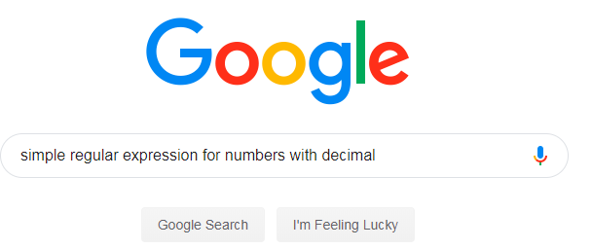
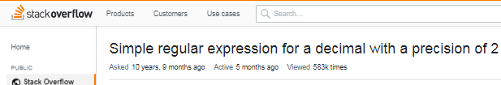
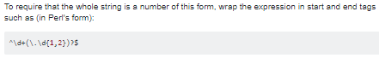





The regex development process
← 583K views
1.23
^\d+(\.\d{1,2})?$
\n1.23
Notes:
Here’s a typical example of the regex development process, based on results from our developer survey.
*Great, let’s put it into our Ruby program.
*We’re good software engineers, so we write a test case, which it passes.
Unlike most code snippets, regexes can flow unchanged across language boundaries.
Programming languages have similar regex syntaxes, so re-used regexes may compile without modification.
However, surface-level syntactic compatibility can mask more subtle portability problems.
If regex semantics vary, then a regex will match different sets of strings across programming languages, resulting in logical errors.
*Here in Ruby, another input also passes – this time unexpectedly.
*I wanted to require the whole string to match, but in Ruby the ^ anchor only restricts to the beginning of each line within the string.

Slide 6
Research
Notes:
I hope I’ve persuaded you that regexes are widely used for diverse purposes, and that typical development workflows might lead to interesting portability problems.
Now, let’s dive into the research.

Slide 7
Research questions
Developer perspectives
Do developers re-use regexes?
Where do developers re-use regexes from?
Do developers believe regexes are a lingua franca?
Measuring regex re-use
How commonly are regexes re-used? (other software ; Internet)
Empirical portability
Different regex semantics?
Different regex performance?
Notes:
We divided our research questions across three themes.
*The first theme was qualitative: what do developers think and do during regex development?
*In our second theme, we corroborated the re-use practices that developers described by measuring regex re-use in open-source software.
*In the third theme, we empirically evaluated the regex portability problems that developers might encounter, considering both semantics and performance.
----
Our experiments covered two aspects:
Semantic portability: When and why do regexes have different semantics across ProgLangs -- match different sets of strings in different programming languages?
Performance portability: When and why do regexes have different worst-case performance in different programming languages?

Slide 8
Developer perspectives Developers’ Regex Re-use Practices
Notes:
In the first theme, we studied developer perspectives on regexes.
To do this, we designed a survey on regex practices and shared it with professional software developers.

Slide 9
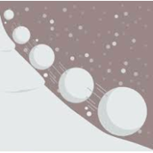


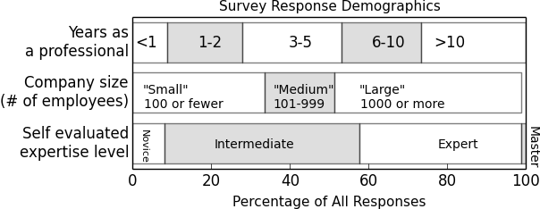
Survey methodology and respondents
33 questions, closed / open-ended. IRB.
Regex process, re-use practices, and portability
Median developer
Notes:
*Design
*Delivery
Responses:
About half from direct and transitive acquaintances.
About half from Reddit/HN.
*This figure summarizes the demographics of our respondents on working years, size of company, and regex expertise.
*The median respondent:
has 3-5 years of professional experience,
works at a medium-size company,
and claims intermediate regex skill.
--------
They were fairly diverse set on these metrics
Ranged from first-year developers to career professionals
Worked at small-to-large companies
Self-report: some novices, many intermediate/expert

Slide 10
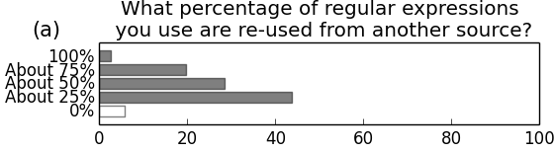
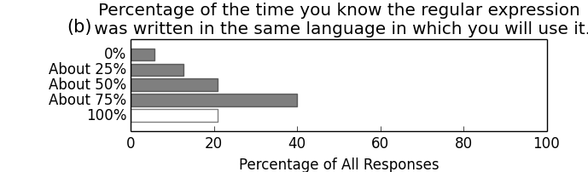
Respondents re-use regexes across languages
94% of developers re-use regexes
When re-using, developers are rarely confident that
the regex comes from the same programming language
Notes:
94% of respondents reported re-using regexes at least 25% of the time.
We asked them how often they knew the regex was being re-used in the same language.
They were rarely confident that this was the case.

Slide 11
Measuring Regex Re-Use Polyglot Regex Corpus
Notes:
Developers reported regex re-use practices, copy/pasting regexes from other source code (e.g. their company’s mono-repo), and from Internet sources like Stack Overflow.
To corroborate this characterization of practice, we collected a polyglot regex corpus and measured the extent of regex duplication between software projects written in different programming languages.

Slide 12






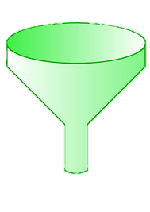


Regex collection methodology
Module regex extraction
Module selection
Unique regexes
Top 25K
Notes:
We collected regexes like this.
For each language, we identified the largest module registry.
We mapped those modules to GitHub and sorted them by the number of GitHub stars they have, which gave us a registry-independent measurement of importance.
For each of the top 25K modules, we statically extracted regexes from the master branch.
This gave us a set of unique regexes for each module, which we merged into a larger corpus.

Slide 13


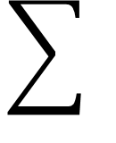
Regex corpus
Num. modules
Unique
regexes
25K
150K
”
20K
”
45K
”
45K
193K modules
580K unique regexes
”
150K
”
20K
All (30K)
140K
All (10K)
2K
Notes:
In total, we extracted regexes from 193K modules written in 8 programming languages.
After accounting for duplicates, this gave us a polyglot corpus of about half a million unique regexes.
---
193,524 modules
As you can see, we found more regexes in some languages than others.

Slide 14
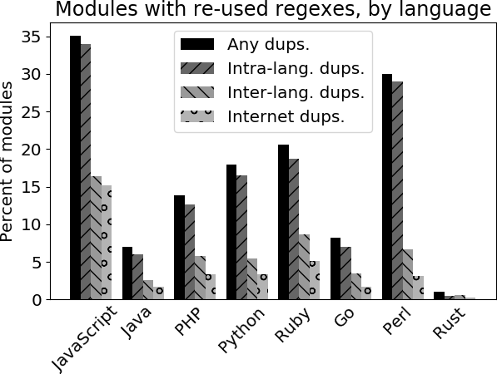
“Complex” regex re-use by module
Notes:
In building our regex corpus, we tracked the regexes extracted from each module.
To understand regex re-use, we measured the extent of re-use between the modules in our registry sample.
This chart plots the percent of modules that contained a complex regex that appeared in more than one module.
We report that
*In 20% of all modules, we found a complex regex that appeared in some other module, in the same or a different programming language,
*About 7% of the corpus modules contain a complex regex that appears in more than one language,
and
*5% of the corpus modules contain an exact copy of a regex we found on Stack Overflow
These measurements generally corroborate the description of regex practices from our survey.
It appears that the developers of open-source software also copy-paste regexes, including across language boundaries.
----
By complex I mean it is at least 15 characters long -- and thus unlikely to be independently derived.
Although some of these regexes may have been derived by other means – independent creation, whole-sale file duplication, etc. …

Slide 15
(Empirical) Portability Semantic + Performance Differences
Notes:
In the first set of research results, I reported that developers say they re-use regexes across language boundaries.
Just now, I showed that measurements on our corpus corroborate their report.
These findings made us wonder: What might go wrong with this regex re-use practice?
To answer this question, we ran two “what-if” experiments to understand the possible problems empirically.
We studied both semantic and performance differences.
By a semantic difference, I mean that a regex matches different sets of strings in different languages.
By a performance difference, I mean that a regex takes a noteworthily different amount of time to complete a match – some change in the worst-case complexity.

Slide 16
What-if experiments using regex testers
match regex against input
if match:
emit matched substring
emit capture groups
else:
report “no match”
/(\d+).\d+/
&
3.14
Match
substring “3.14”
capture “3”
Notes:
To perform our what-if experiments, we used a common set of regex testers.
The regex testers all follow the same simple algorithm: …
We implemented this algorithm in each of these languages.
*As an example, suppose we have the regex … and the input “3.14”.
*This regex will match the input. It will match the substring “3.14” – the whole string, in this case.
The regex contains one capture group, the integer prefix of the string, and our tester will also emit the contents of this group.

Slide 17



Semantics: Methodology
Rex, MutRex, EGRET, ReScue, BRICS
Input generators
Both match? | Same substring? | Same captures?
Regex testers
Language semantic analysis
(pairwise)
Notes:
Here is the methodology we used to identify semantic portability problems.
*To measure semantic differences, we needed a set of inputs to determine the strings a regex matches and the strings it does not match.
We used five state-of-the-art regex input generators to generate input.
Using our input generator ensemble, we produced about 2500 unique inputs for the median regex.
*We then fed these inputs to our regex testers and collected the results.
*To analyze, we compared the results for each pair of languages.
COMPARING the results matches can produce four distinct outcomes:
First row: They both mismatch, or they match and agree on everything (no disagreement)
They both match, agree on the matched substring, but disagree about the contents of capture groups
They both match, but report that different substrings matched
One matches and the other does not
When two languages disagree on the behavior for a (regex, input) pair, we call this a “difference witness”.
Difference witnesses fall into one of three categories: capture, substring, and match witnesses.
-----------
ReScue: modified to emit the randomized inputs it explores in its search for super-linear behavior
BRICS: modified to emit random subsets of inputs instead of an exhaustive set (infinite / very large for our purposes)

Slide 18
Copy/pasting regexes leads to semantic differences
8% had a match witness
4% had a substring witness
7% had a capture witness
In total, 15% of regexes (82K) had a difference witness
Notes:
We identified at least one difference witness for 15% of the regexes.
These are regexes that compiled in some pair of languages but disagreed in some way about the match.
Among those:
8% of the regexes had a match witness
4% had a substring witness
7% had a capture witness
This means that, ceteris paribus, about 15% of the time a developer copy/pastes a regex across a language boundary it will have different behavior in the new programming language. Assuming the behavior of the regex in the old language was “correct” according to application semantics, some regex porting will be required.

Slide 19

Some sample results of semantic differences
Witness | Language 1 | Behavior 1 | Language 2 | Behavior 2
\cC |  | ctrl-C |  | “cC”
^a |  | Begin input |  | Begin line
a++ |  | Possessive quantifier |  | Quantifier
[ ] ] |  | “]” |  | Empty capture group
Undocumented behaviors
Notes:
The full details of the differences we identified are in the paper, but I’d like to show you some illustrative findings here.
The first behavior is the “expected” behavior (normal across several languages), while the second behavior is the “surprising” behavior – unique to the language or shared by a few.
Regex engines are complex and under-specified, and not all of these behaviors were documented.
We found that there’s no substitute for actually evaluating regexes in different languages and comparing how they behave.

Slide 20

Performance methodology
SL regex detectors
Per-lang. complexity
Notes:
This brings us to the second part of our experiments: portability differences.
Prior research has shown that regex matches can have linear, polynomial, or exponential complexity in the length of the input.
This match time can vary by language for the same regex and input, based on the algorithm that a language’s regex engine uses to perform the match.
However, we don’t have a good picture of the differences between the regex engines in each language, so we checked experimentally.
Why does this matter?
Well, suppose a regex is copied from a language in which it has linear performance to one in which it has polynomial or exponential performance.
This introduces a potential security vulnerability.
If this regex is used in server-side code that handles client input, then an attacker could trigger this algorithmic complexity and perform a Regular Expression Denial of Service attack.
To understand the algorithmic complexity differences between the regex engines in each language, we used an ensemble of four super-linear regex detectors to identify possible super-linear behavior. Then we used our per-language regex testers to check the worst-case behavior in each language, labeling each regex as linear, polynomial, or exponential in the worst case.

Slide 21
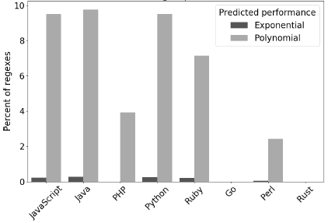
Performance results
Notes:
This chart shows the percent of regexes in each language that exhibited exponential and polynomial worst-case behavior.
As you can see, we identified three distinct families of performance:
JS, Java, Python, and Ruby
PHP and Perl
Go and Rust
The “Slow” and “Medium” engines use variations on Spencer’s algorithm, while the “Fast” engines use Thompson’s algorithm.
Details about the algorithms used in the three classes are in the paper.
The implication: Moving regexes from a fast language to a medium one, or from a medium to a slow one, may be dangerous from a security perspective.
----
We expected to see two classes of performance:
“Slow” regex engines that use a backtracking-based algorithm, and
“Fast” regex engines that use Thompson’s BFS algorithm.
We see these two classes, as well as a “Medium” class for PHP and Perl.
We studied the implementations of PHP and Perl’s regex engines, and identified the defense mechanisms that enable them to handle more regexes quickly.
Details are in the paper.

Slide 22
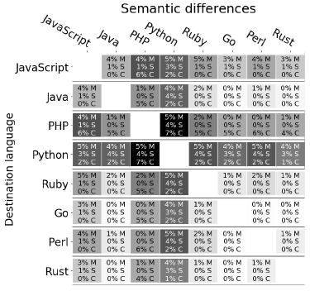
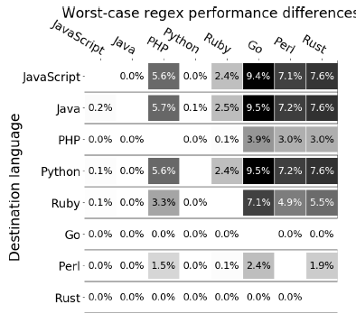
Summarized in developer-friendly heatmaps
Notes:
We think a good way to visualize our experimental findings is through heatmaps illustrating the pairwise semantic and performance differences between languages,
The darker the cell, the riskier it is to move regexes from that source to that destination.
We hope these will benefit practitioners thinking about copy/pasting regexes.

Slide 23
Closing Remarks

Slide 24
Regexes are not a lingua franca
Survey: developers say they believe and act like they are
Empirical re-use study: regexes are re-used
Portability experiments: Correctness, security concerns
Thank you for your attention
Notes:
* survey
* Empirical corroborates
But
*Our portability experiments demonstrate the correctness and security concerns that may arise from this practice.
Takehome message
On the whole, we believe our study shows that:
Regexes are a misunderstood programming language feature
There is tons of room for more research in this space; come join us!

Slide 25

Bonus material

Slide 26
False negatives in the SL regex detectors
The SL regex detectors are using fullMatch semantics
Regex engines sometimes implement partialMatch…unwisely
Thus, and somewhat horrifyingly:
/(a+)b/ may be super-linear
Equivalent to the fullMatch /^.*?(a+)b/ ← QOA

Slide 27
Why not applications?
Open-source applications may not be representative of code in industry
Module ecosystems are shared by open-source and industry
Modules are sometimes authored by industry as a way to give back to the open-source community

Slide 28
Why git projects instead of artifacts?
Bundling / Obfuscation complicates analysis on registry artifacts

Slide 29
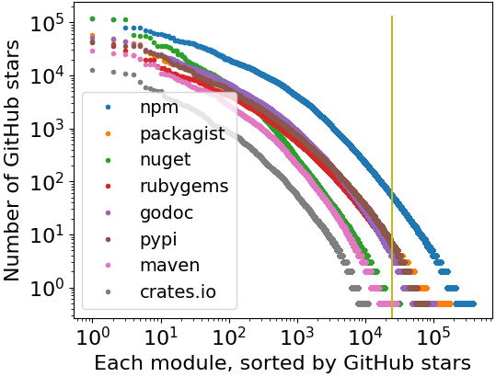
Cut-off point for “popular modules”
First 25,000 modules
JS: ~60 stars
Others: <10 stars
Rust: 13K modules

Slide 30
Registries and Languages
Notes:
TODO Missing Java, Golang; and in the wrong order
Python: Pypi
JavaScript: npm
Rust: Crates
PHP: Packagist
Perl: CPAN
Ruby: Rubygems
Java: Maven central
Go: (TODO)

Slide 31
Why modules, not applications?
Modules are comparable building blocks
Strings
Math
Command-line scripting aids
Graphics
We think modules are
more comparable across languages
than applications would be.

Slide 32
Getting modules from a registry
API: “All module metadata”
API: “Modules by first letter”
Filter for github.com URLs
API: Per-module info
465,030 modules
Filter for github.com URLs
100,954 modules

Slide 33
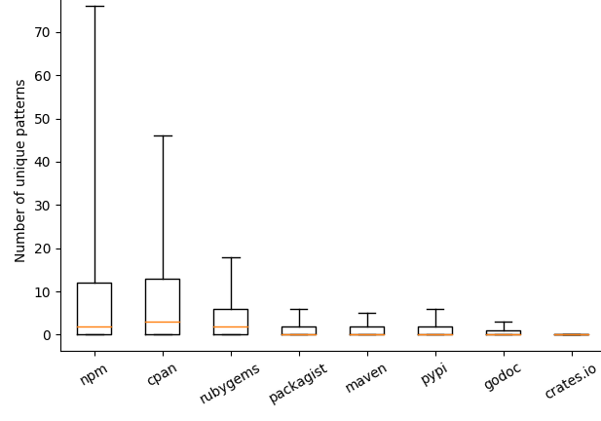
Unique regexes per module

Slide 34
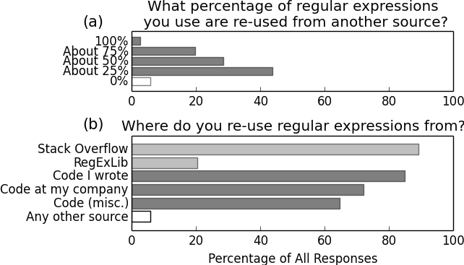
Regex re-use practices

Slide 35
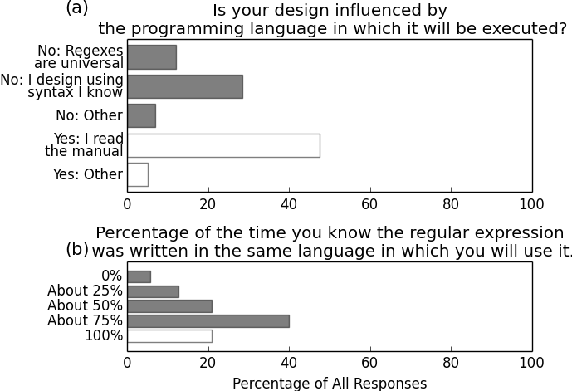
Regex portability beliefs

Slide 36
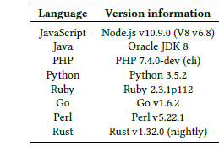
Language versions used in experiments

Slide 37
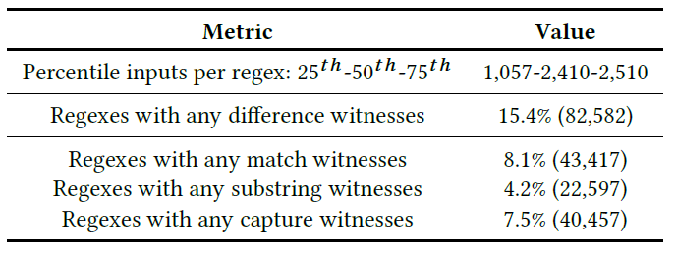
Input generation results
Notes:
Half of these had match witnesses (match vs. mismatch), a third had substring witnesses, and half had capture witnesses.

Slide 38
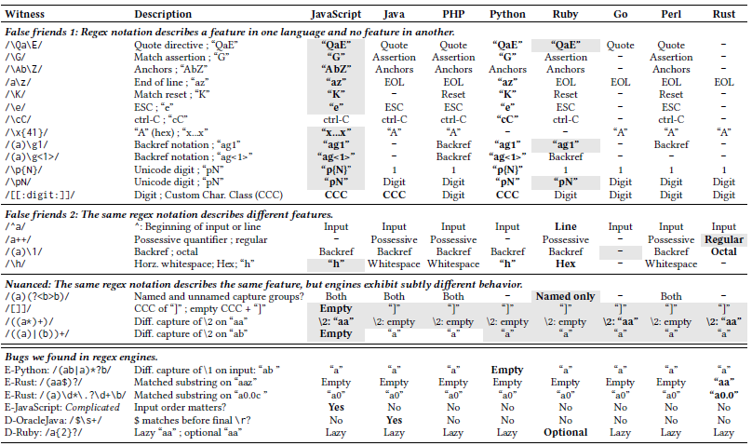

Slide 39








Analyzing Regexes
350K
60K
1. ReDoS regexes
2. Degree
[R&T ‘14]
[WMBW ‘16]
[WOHD ‘17]
3.6K
(1%)
704
(1%)
13K
(3%)
705
(1%)
Notes:
TODO This is just filler
1. ReDoS Regexes
Talk through flowchart.
From this we learn that ReDoS regexes occur a lot in practice – thousands of ReDoS regexes occurring in over 10K modules.
ReDoS regexes make these modules, as well as any modules and applications that depend on them, potentially vulnerable to ReDoS.
2. Degree
We wanted to know how concerned developers should be about these regexes.
Exponential behavior is rather more problematic than polynomial behavior.
We measured match time on varying-length inputs.
Then we fitted exponential and polynomial curves to the data.
We chose the curve of best fit.

Slide 40


Regex re-use in modules (“Complex” regexes)
Every language has complex regexes
that appear in other languages
Systems languages
Regexes are rare
Duplication is rare
JS: Highest re-use rates
Notes:
This chart shows the extent of regex duplication between the modules in our registry sample.
In keeping with the phrasing in our survey (“copy/pasting regexes”), we label as re-use any pair of identical regexes (string equality).
To eliminate trivially identical regexes like /\s/, we conservatively require any matching regexes to be at least 15 characters long. While it is possible that two developers might independently produce the same (longer) regex, this seems unlikely given that hundreds of distinct regexes have been reported in prior work even for “simple” languages like emails.
*Explain the metrics
*Indicate that JS has the highest re-use on each metric, and use this to explain each bar height.
*Contrast the “scripting” languages (higher regex USE and RE-USE) with the compiled/systems languages (lower regex USE and RE-USE).
*Key point here: cross-language re-use appears in every language, including, interestingly, across languages.
5% of all modules contain regexes also found on SO or REL

Slide 41
Regex collection methodology
Module regex extraction
Module selection
HEAD • static analysis
Unique regexes
Top 25K
Notes:
TODO: Update numbers
TODO: Star counts as a proxy for popularity that would be consistent across languages
TODO: Modules, not applications?
Walk through the flow-chart

Slide 42
Comparing specifications (in the form of language documentation) was a starting point, of course.
But regex engines are complex and under-specified,
so there’s no substitute for actually evaluating regexes in different languages and comparing how they behave.

Slide 43
As it turns out, both engines have defense mechanisms to avoid long-running regex evaluations.
They both use a counter-based scheme to short-circuit long-running evaluations with an exception.
In addition, Perl maintains a limited backtracking cache to avoid some redundant searches.
As you can see, neither defense mechanism is complete; there is still polynomial and exponential behavior to be found there.
But these mechanisms may be a good idea for other regex engine maintainers to consider.

Slide 44
(Some) Limitations and Future Work
xxx
Notes:
Of course, our work has some limitation
ns.

Slide 45

Some regex examples
/^a+$/ ← Some ‘a’
/\d{1,3}\.\d{1,3}\.\d{1,3}\.\d{1,3}/ ← IPv4
/^[a-zA-Z0-9]+([._]?[a-zA-Z0-9]+)*$/ ← Username
Notes:
Generally speaking, regexes are a means of encoding a string language: some subset of all possible strings
In case it’s been awhile since you worked with regexes, let me refresh your memory with some examples.

Slide 46
What are regexes used for?
30-40% of Python and JavaScript projects
Diverse purposes
User-agent string → Server-side rendering
Source code → Linters
File names → Command-line tools
Tokens → Lexers
HTML → Browser plug-ins
Email → Input validation
Notes:
Regexes are widely used, estimated to appear in 30-40% of Python and JavaScript projects.
They are used for diverse purposes.
Our prior empirical work has identified many common application areas, including
X, used in Y

